Slide 1

CLIENT
SAMPLE PROJECT #1
Beeline
Adding Supplier and MSP product lines (covering the emphasize and define phases of the Design Thinking process)

Slide 2
CLIENT
PROJECT
Beeline
Adding Supplier and MSP product lines (emphasize and define phases)
PROJECT DESCRIPTION
KEY PLAYERS
Beeline helps their clients manage contract labor, from beginning to end. We were changing the legacy app from one do-it-all interface for all users into individualized, persona-based feature lines.
Chris d’Aquin Sr. Product Designer
Judy Bumgarner VP of Product Strategy
Daniel Sudhindaran Director of Product Design
Cody Abraham Product Manager
Sarah Schuler Product Manager
Two consultants From Fuego UX
(For a fresh perspective and to help conduct user research)
BUSINESS PROBLEM
Hiring a new contractor is lengthy, complex, and involves multiple touchpoints from four different personas. How can we:
make common roadblocks in the process easy to identify and overcome?
eliminate confusion by providing clarity to current statuses and conditions?
provide each persona with easy access to their most common priorities?
HOW WE ATTACKED THE PROBLEM
Two months of product and user research
Task priority surveys sent to ~500 users
Outlined the different journey maps for each persona
Design Thinking/Brainstorming sessions to put it all together

Slide 3
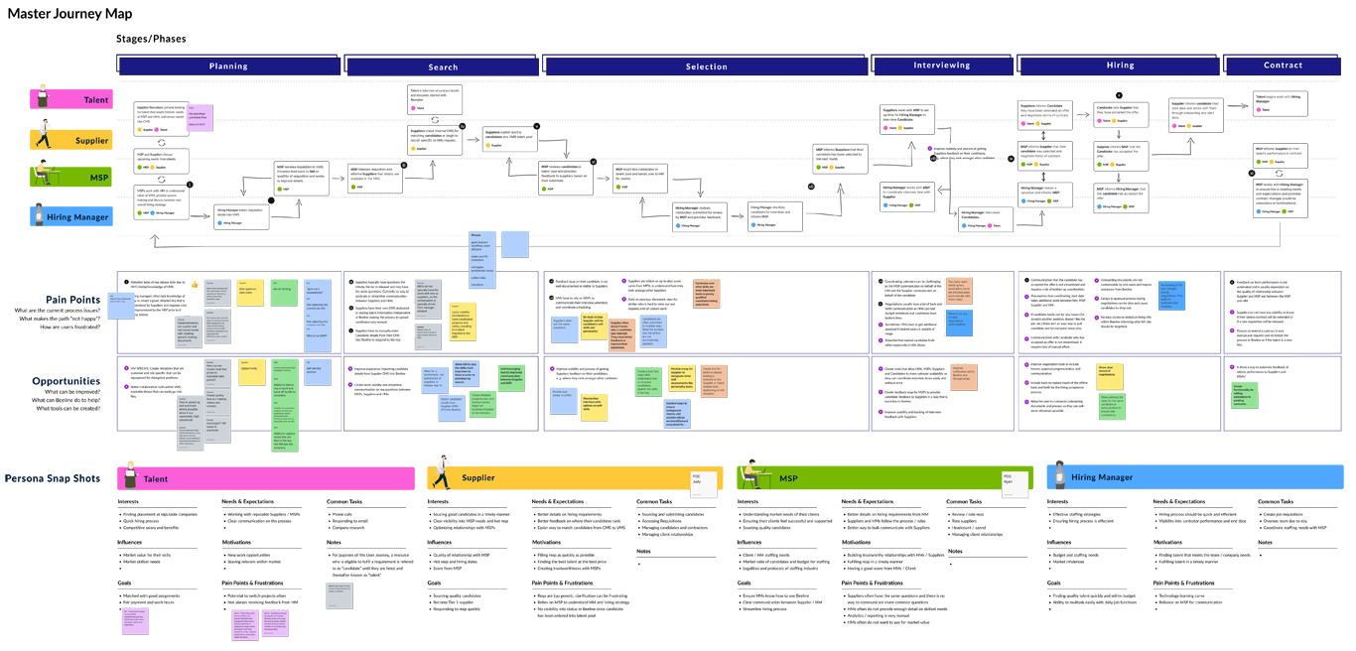
CLIENT
PROJECT
Beeline
Adding Supplier and MSP product lines (emphasize and define phases)
HOW MANY BRAIN STORMING SESSIONS?
After three sessions, we had our master journey map! This identified how all different product lines interacted and what features to add. We were ready for the next design phase – wireframing.

Slide 4
CLIENT
SAMPLE PROJECT #2
Beeline
Prototype testing of new Talent product line (covering the iteration and testing phases of the Design Thinking process)

Slide 5
CLIENT
PROJECT
Beeline
Prototype testing of new Talent product line (iteration and testing phases)
PROJECT DESCRIPTION
KEY PLAYERS
Beeline was redesigning the interface shown to contractors (the talent persona) when they entered hours on their timesheet, as well as adding additional usefulness and functionality.
A random mix of employees in the Beeline office who didn’t have any knowledge of the project.
HOW I ATTACKED THE PROBLEM
We didn't need a lot of users to test how smoothly users would progress through the account creation process and if the information architecture made sense.
I spent three hours walking through the office with a laptop, grabbing people who were away from their desks for a quick 10-minute prototype test.
BUSINESS PROBLEM
We had gone through several wireframe iterations and had our first prototype. How well did it work, especially for someone using who needed to create an account and was using it for the first time?

Slide 6
CLIENT
PROJECT
Beeline
Prototype testing of new Talent product line (iteration and testing phases)
WHAT DID WE DISCOVER?
BUT…
With just seven prospective users, we found the prototype was easy to navigate and understand.
We discovered some specific usability issues with password creation, confusion over section labels, and users kept wondering if their updates were “saved” or not.
…AND THE SYSTEM USABILITY SCORE (SUS) SURVEY REFLECTED IT
The design scored well for ease-of-use but failed in areas of confidence and consistency. Despite the poor scores, this test was successful because it led to specific changes in the next iteration.
SYSTEM USABILITY SCORE (SUS) SURVEY RESULTS
*White and green blocks show scores that hit the desired mark. Pink and red blocks show where the usability score doesn’t measure up.

