Slide 1
Testing and Optimization (TAO) Overview
Notes:
I have to give a presentation next week at my departmental meeting about what exactly is the Testing and Optimization team, so you guys get a sneak peek and I get to practice.

Slide 2
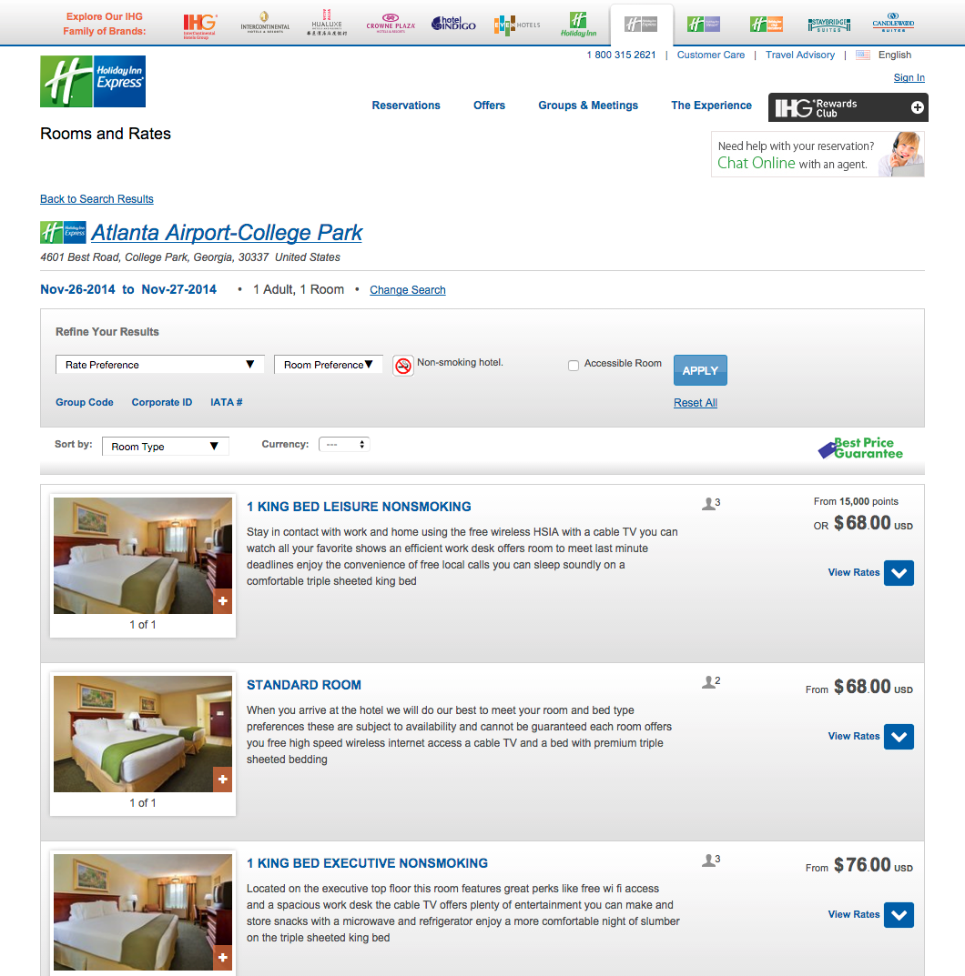
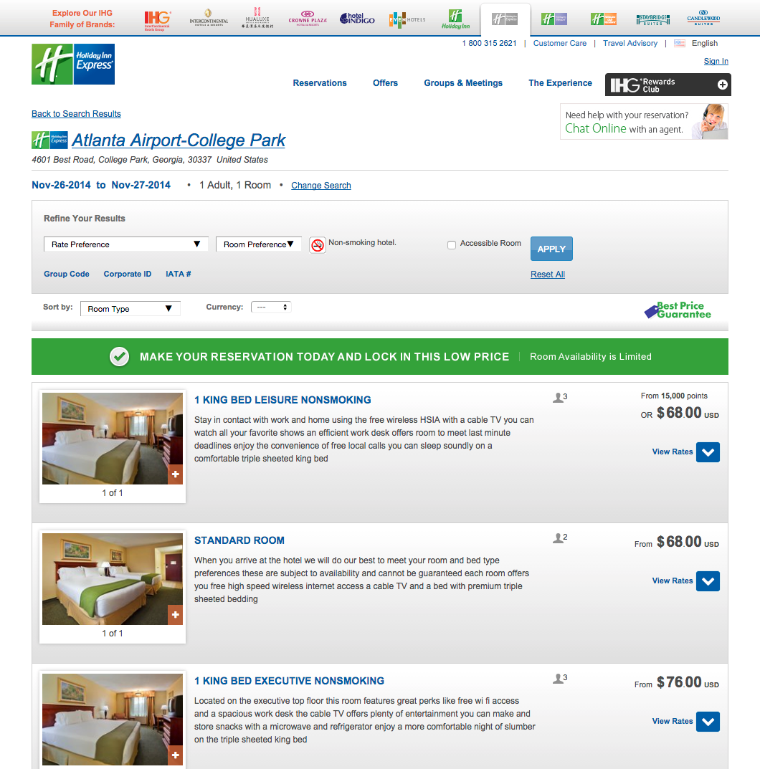
What exactly is A/B Testing?
Compares two versions of a webpage or app against each other to determine which one performs better.
EXPERIENCE A (CONTROL)
EXPERIENCE B
VS
Notes:
A/B testing is a method of comparing two versions of a webpage or app against each other to determine which one performs better. This is also known as split testing or bucket testing. A/B testing uses data & statistics to validate new design changes and improve your conversion rates. We often also test more than one alternative at a time. This is called A/B/n testing, which compares more than two versions against each other in the same test.

Slide 3
Why test?
Testing takes the guesswork out of website optimization
Enables data-informed decisions
Shifts business conversations from "we think" to "we know"
Ensures changes produce positive results
https://www.optimizely.com/ab-testing/
Notes:
Testing takes the guesswork out of website optimization and enables us to make data-informed decisions. These decisions allow us to shift business conversations from "we think" to "we know." By measuring the impact changes have on your metrics, you can ensure that changes produce positive results.

Slide 4
The A/B Testing Hypothesis
If we (make a specific change),
then we will expect (a desirable result) as measured by (desired outcome).
https://www.optimizely.com/ab-testing/
Notes:
When we create a test idea, we always have something specific in mind we want to test. We follow the A/B Testing Hypothesis:
“If we [make a specific change], the we expect [a desirable result] as measured by [desired outcome].”
For instance, we are about to launch a test where we want to emphasize Candlewood and Staybridge Suites to users who are searching for stays that are 5 days or longer. By doing so, we hope to increase the number of guests booking CW and SB hotels. We will measure this by checking the differences in the booking rate between the two different experiences.

Slide 5
What kind of things do we try to optimize?
We test for a variety of things, including:
Increased bookings
Increased enrollments in the Rewards Club
More app downloads
Determine what is most important to our users
https://www.optimizely.com/ab-testing/
Notes:
So what kind of things do we try to accomplish in our tests? By far, the most common item is finding a way to increase our bookings. But it is not the only thing. We often look for ways to increase the things we know will have a significant, even if not a direct, impact to IHG’s bottom line – like increasing our enrollments in the Rewards Club or getting more people to download the IHG app. We will also run tests that help us determine what is most important to our users on specific pages of our site. This information in particular will help us in future redesigns. We can share this information with DXD, and it’s one reason why we work closely with them.

Slide 6
Examples of past tests
Notes:
So enough talking! Let me show you some examples of real tests we have run. Hopefully this will give you a clear understanding of what we do.

Slide 7
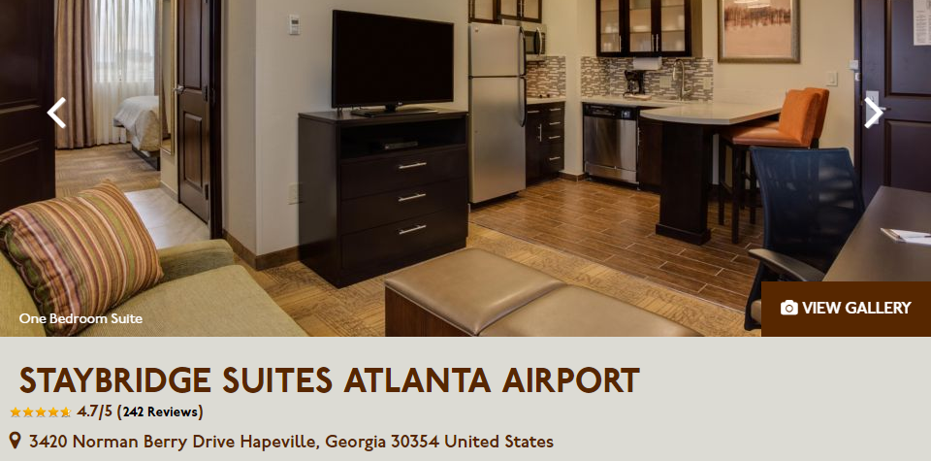
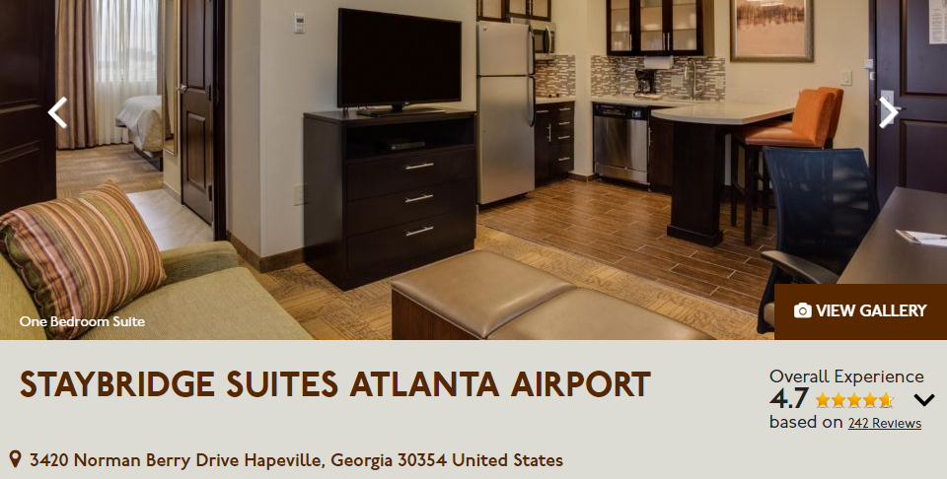
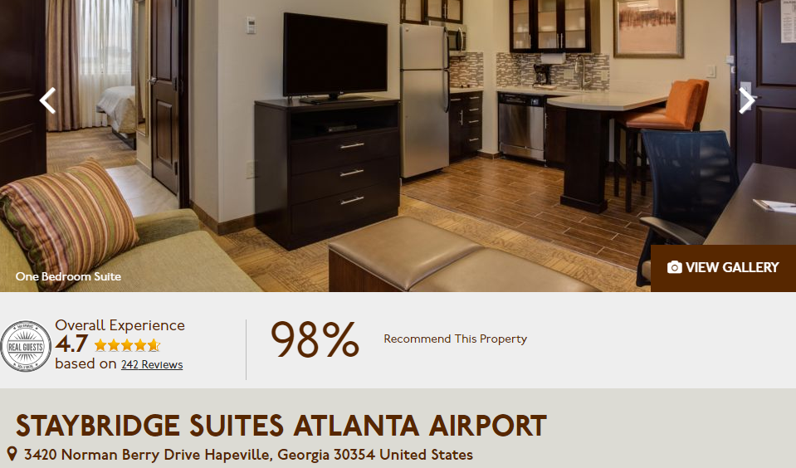
Test: Emphasize Star Ratings
Using Staybridge Suites, we put more of an emphasis on the hotel’s star ratings on the hotel details page.​
EXPERIENCE A (CONTROL)
EXPERIENCE B
VS
EXPERIENCE C
Notes:
In this test, we wanted to see if we could increase bookings at a hotel by emphasizing the user ratings on the hotel detail page for each hotel. We used Staybridge Suites for this test, and here you can see the control, or existing page. In the first alternate, we moved the star ratings out to the side and make them larger. In the second, we put them on their own line and added the percentage of guests that would recommend this hotel to others. In the end neither variant increased bookings, so we didn’t recommend making any change.

Slide 8
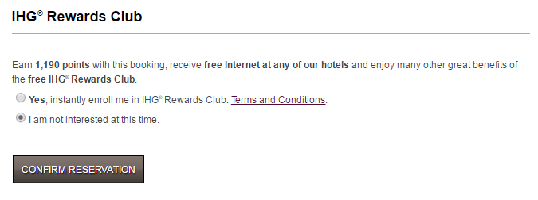
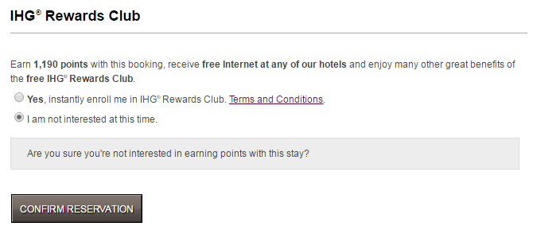
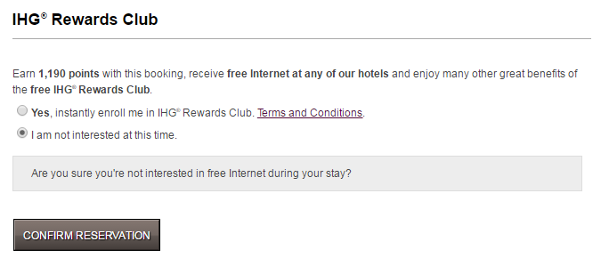
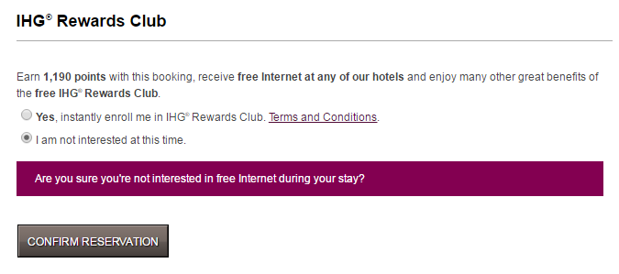
Test: Quick Enroll “Are you sure?”
When the user turned down instant enrollment for the Rewards Club, we tested a “are you sure?” message.​
EXPERIENCE A (CONTROL)
EXPERIENCE B
EXPERIENCE C
VS
EXPERIENCE D
Notes:
Here, we wanted to test quick enroll portion at the bottom of the Guest Information screen. This is where a user will fill out the necessary information to make a reservation and at the end we ask if they would like to enroll in the Rewards Club. If they chose “no,” we wanted to hit them with a simple “are you sure” type question. The first alternate version asks are you sure you want to miss out on earning points for this stay? The next two ask are you sure you’re not interested in free internet during your stay? This tested really well, with the free internet question doing better than the points question. We have just wrapped up a follow-up test to this one and will be making a recommendation soon for a change.

Slide 9
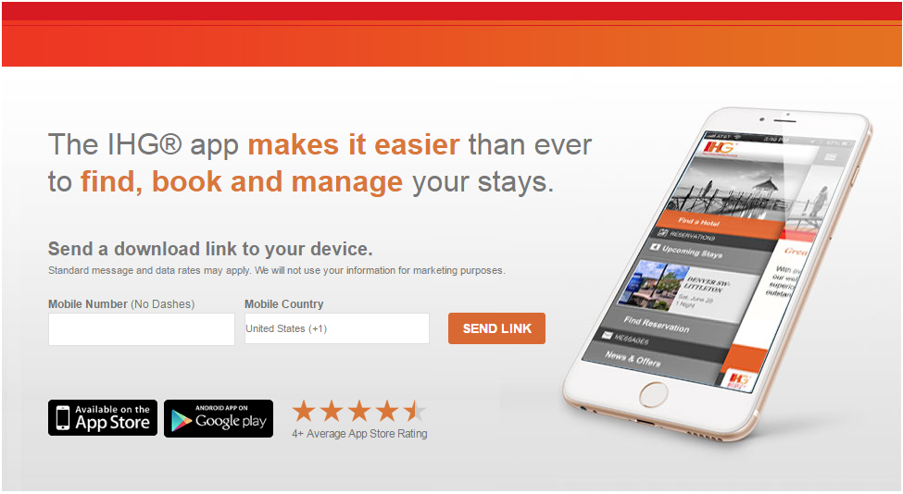
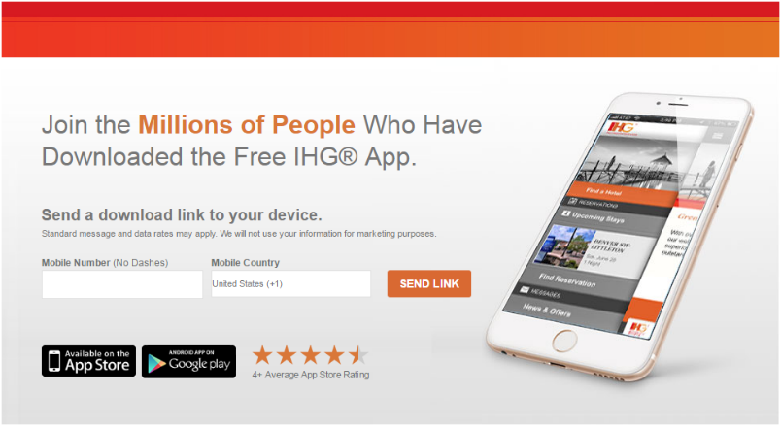
Test: App Download Photo & Headlines
We updated the main image and headline on the App Download page.​
EXPERIENCE A (CONTROL)
EXPERIENCE B
VS
EXPERIENCE C
Notes:
In this test, we wanted to test the app download page. Would showing the screen of our app make users more likely to download the app? We also tested two different messages here. Surprisingly, both variations got fewer downloads than the control, so we didn’t recommend a change.

Slide 10
Deep dive on one particular test
Notes:
Now let’s do a deeper dive on one more test. But with this one, I want you to decide which variation you think did the best.

Slide 11
Test: YOUR RATE Block Optimization
What is Being Tested
Rooms & Rates page – specifically the new and potentially confusing YOUR RATE.
Why it is Being Tested
To make it easier to understand that while this is a members only rate, you can join as you book the room.
Notes:
As everyone knows, the new YOUR RATE was a big push for IHG earlier this year. But we were afraid some users were a little confused by how we displayed it on the Rooms & Rates page. Some didn’t know they could simply join the Rewards Club as they booked the cheaper rate. So we designed a test that tried to make this more clear. For this test, our hypothesis was “If we make it easier to understand you can join while booking the cheaper rate, then we will expect more people to sign up and join, as measured by the number of conversions for the member rate.

Slide 12
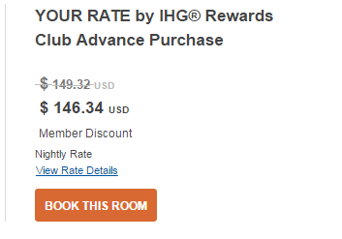
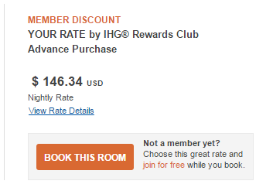
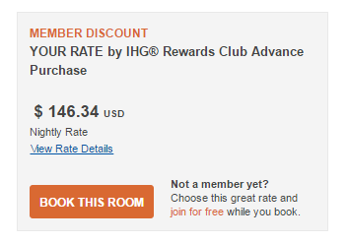
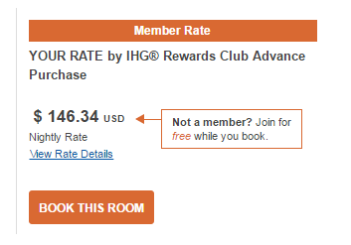
Test: YOUR RATE Block Optimization
EXPERIENCE A (CONTROL)
EXPERIENCE B
EXPERIENCE C
VS
EXPERIENCE D
Notes:
So here is our control on the left, and we came up with three alternatives. The first simply added “Not a member yet? Choose this great rate and join for free while you book.” It also put a small box around the button and this question. The second expanded the box around the whole thing. The third put the question into its own box with an arrow pointing to the cheaper rate.

Slide 13
Test: YOUR RATE Block Optimization
EXPERIENCE B
EXPERIENCE C
EXPERIENCE D
Overall Bookings
+1.30%
+0.51%
+0.24%
Member Rate Adv Purchase
+14.97%
+9.08%
+16.49%
Notes:
So what do you think? Which one did the best? Let’s look at overall bookings first. This actually came out flat with very little change over the control. But this is a good thing! You don’t want to create a variant that increases membership but actually hurts overall sales. What this shows is all three of our variants didn’t affect the overall booking negatively. So let’s look at what we really wanted to track – Member Rate Advance Purchase. All of them were winners! But A and C did best. So now you know what the Testing and Optimization team does. Because I get to do things like this, I love my job! It can be a lot of fun not only to devise these tests, but then to analyze the results and try to determine what we should do next.

Slide 14
Questions
?

Slide 15
Questions
?

Slide 16
Questions?

