Slide 1
Usability Lab
Review of proposed new design for Compare Candidates
July 12-16, 2021

Slide 2
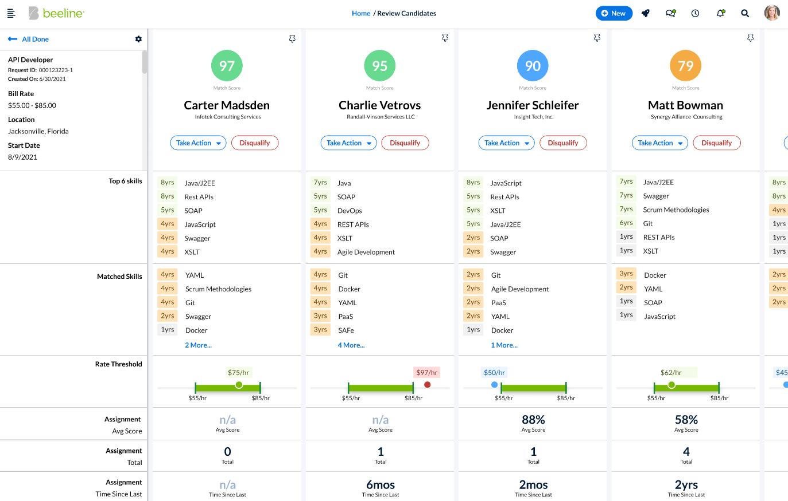
What did we test?
Candidate Compare
The Product Design team had created a new view for comparing candidates using a more side-by-side layout.
After several rounds of internal design iterations, we conducted a total of 10 one-on-one sessions with external customers for their feedback.

Slide 3
Executive Summary
Overall we had a very positive reaction
Everyone expressed positive to very positive comments on the design as a whole. They all felt this was an improvement to the current Candidate Evaluation screen and many specifically said it would save time for hiring managers.
Most of the questions/concerns expressed by the participants should be covered by items already planned for release. We need to include these features before the next test to make sure our assumptions are correct.
Areas receiving the most positive comments
Overall organized very well
Easy to make direct comparisons
Usefulness of Match Score and benefit of ordering candidates from highest to lowest match.
Graphical representation of skills, rate, and industry experience was very clear and immediately readable
Key findings from the Usability Lab
While we are certainly on the right track, testing revealed some areas that need tweaking. The SUS scorecard revealed most participants felt there was missing information. The two most mentioned by far were “Availability Date” and “Date Submitted,” which should be easy to add.
Many also wanted the ability to see the candidate’s resume from this screen. This needs further evaluation. Resumes are available in other easily accessible screens, including the one immediately before this view.
This issue, along with a few less common concerns, signifies our next round of testing needs to expand to include most (if not all) of the Review & Evaluate journey map. We expect if the user goes through the full process to review and evaluate candidates then their concerns to view resumes in this tool and the other items will greatly diminish or completely disappear.

Slide 4
Testing Details
User Personas Targeted
Hirer (Manager, Supervisor)
Program Operations (MSP, VMO, etc.)
Journey Maps Affected
Review & Evaluate (Sourcing)
Testing Methods
This was a moderated test. All sessions were performed remotely and recorded through Teams. The high-fidelity, interactive prototype was demonstrated, not hands-on for participants.
Primary Benefits
To validate a prototype
Confirm feature meets expectations
Test Participants By Persona*
Hirer – 2
Program Operations – 8
System Administrator – 2
*These numbers may add up to more than the total number of participants because some had more than one role.
Test Participants Pulled From
Beeline Advisory Council
MSP Partners

Slide 5
Usability Questionnaire
1 – Strongly Disagree
2 – Disagree
3 – Neutral
4 – Agree
5 – Strongly Agree
Evaluating how our users felt
We hit or exceeded the mark on 8 out of the 10 questions, which is very good! This helps confirm we are on the right trail. We scored a ‘B’ on the overall grade.
Where we did well
The new Candidate Compare scored well in multiple categories, particularly in questions about using this frequently (#9), feeling confident (#1), and learning things quickly (#7). It’s interesting that users felt confident and wanted to use this frequently even though there were some issues with labeling and missing content (see “What needs improvement”).
What needs improvement
We scored badly on two questions that seem to be related. Almost all users asked for both “Availability Date” and “Submitted Date,” which were missing, and also a way to see the candidate’s resume directly in this view. They also had a total lack of understanding how the Match Score was calculated. Several users wasted time trying to figure it out for themselves.
The design of the test itself also proved to be short-sighted. We dumped users right into the Compare Candidate view without leading them through Beeline’s Hiring Manager Experience to get to the screen. This added confusion to the users that could have been avoided.

Slide 6
Future Action Items
Create guided tour
We had already planned on doing a guided tour and several specific findings indicated this would be valuable in helping the user understand how to access several points of functionality and meaning.
Add “Availability Date” and “Submitted Date”
The majority of participants specifically asked for these two items.
Provide explanation of scoring algorithm
During testing, nearly all participants asked multiple questions about how the Match Score was created. Several participants expressed a lack of trust of its accuracy. Providing an explanation of what contributed to a match score for a candidate will greatly boost user trust and usability.
Include more of journey map on next test
Some of the questions and concerns may have come out because we showed only the new Candidate Compare design. Showing more of the Review & Evaluate journey map in a fully-functional prototype may eliminate some concerns and validate which ones we need to include in this design.

